Slide 1
Data Engineering Best Practices
Kerry Nakayama

Slide 2
Infrastructure and Security
Kerry Nakayama

Slide 3

Objectives
Test, Deploy, Maintain
Testing
Integration of Tests
Maintenance of existing architecture
Networking & Security
VPC and internal private networks
PII data
Permission Rules by Roles
Maintenance around Infrastructure
Idempotency
Parallelization
Compression of data
Block Store and Mounting

Slide 4
Test, Deploy, Maintain
Everybody Wants Their Own Sandbox
Easy to create exact copies without duplicating infrastructure, without copying data
create what we call “zero-copy clones”
multiple independent compute clusters (“virtual warehouses”) access the same data
Notes:
Everybody Wants Their Own Sandbox
There’s an identical problem when it comes to data warehousing and analytics. Engineers need a copy of the data warehouse and its data to develop applications, QA needs a copy for testing those applications, the operations team needs a copy for staging, and then of course there’s the production environment and the need for different groups of BI users, data scientists and analysts to have their own copy of the data warehouse and its data in order to avoid overloading the data warehouse.
That’s no longer necessary with Snowflake. In Snowflake, it’s easy to create exact copies without duplicating infrastructure, without copying data, and without worrying about whether your different deployments are out of sync with each other.
Snowflake Elastic Data Warehouse is the ability to create what we call “zero-copy clones”—copy-on-write clones that do not require any storage space to create
The last thing needed to make this possible is Snowflake’s multi-cluster, shared data architecture. The ability to have multiple independent compute clusters (“virtual warehouses”) access the same data without competing for resources is what makes it possible to avoid needing to copy data to a different system.
can all run at the same time, without requiring data copying and data movement.

Slide 5
Testing in Data Engineer Environments
Enable your pipeline to handle concurrent workloads
Tap into existing skills to get the job done
Use streaming instead of batch loading
Invest in tools with built-in connectivity
Incorporate extensively
Enable data sharing
Choose the right tool for wrangling data
Build data docs and catalogues
Rely on data owners for security policy
Notes:
As new tools and self-service data pipelines eliminate traditional tasks such as manually writing ETL code and cleaning data, companies are asking data engineers to provide guidance on data strategy and pipeline optimization
CAN YOUR PIPELINE HANDLE CONCURRENT WORKLOADS?
- Make sure you are optimizing data loading so it will be most useful
- don’t learn new skills –without first mastering the ones you have on hand
ARE YOU USING DATA STREAMING AS WELL AS BATCH INGESTION?
Data is coming at us 24 hrs a day is your team making the most of it
Use tools that all work together and connect the way you work with data
Many items have already been developed. Use that before recreating the wheel
Share data rather than siloing you data
DO YOU USE TEST DEVELOPMENT ENVIRONMENTS?
Test to make sure all transformations are the same- speak to each other
Document and catalougue everything
IS YOUR PIPELINE DEVELOPMENT OPERATIONALIZED?
After creating a pipeline, you may have to modify it or scale it to accommodate more data sources. Design your pipelines so they can be easily modified or scaled. The concept is known as DataOps, or DevOps for data, and it consists of building continuous integration, delivery, and deployment into the pipeline using automation and, in some cases, artificial intelligence. Incorporating DataOps in your pipeline will make your data more reliable and more available.

Slide 6
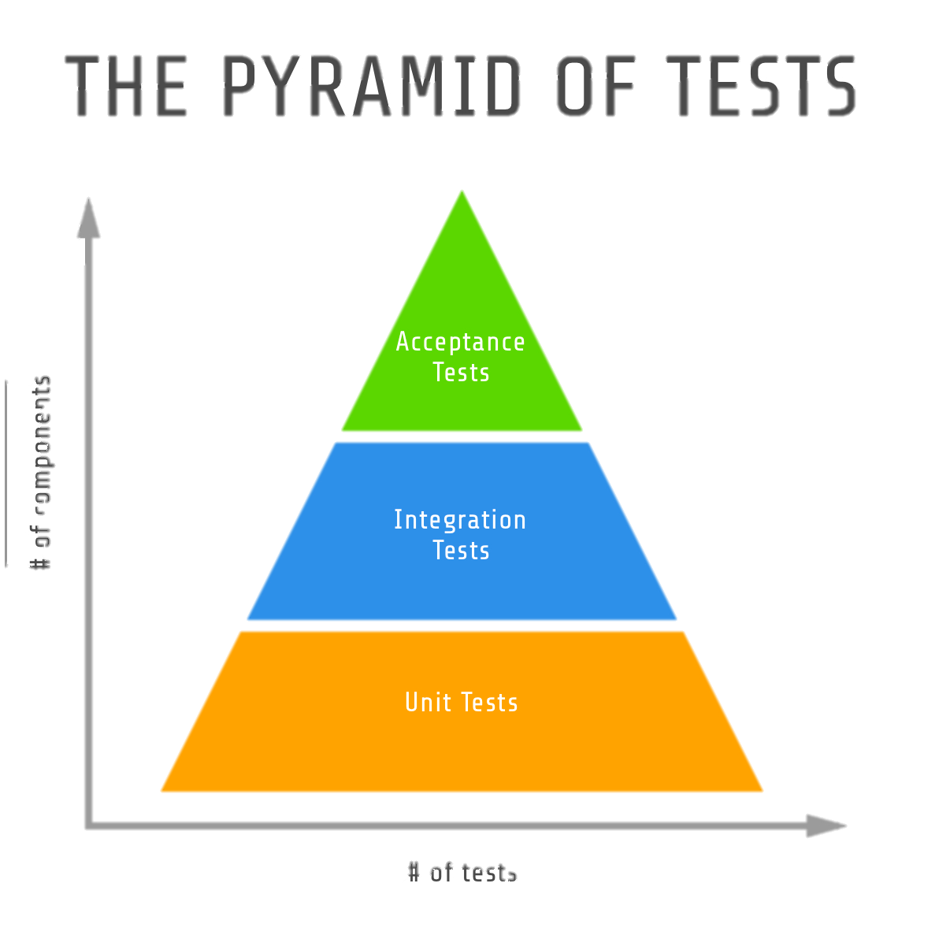
Unit Tests
UNIT TESTING is a level of software testing where individual units/ components of a software are tested.
Purpose is to validate that each unit of the software performs as designed
When is it performed?
Unit Test Plan
Prepare
Review
Rework
Baseline
Notes:
Unit Testing Method
It is performed by using the White Box Testing method.
When is it performed?
Unit Testing is the first level of software testing and is performed prior to Integration Testing.
Who performs it?
It is normally performed by software developers themselves or their peers. In rare cases, it may also be performed by independent software testers.
Unit testing increases confidence in changing/ maintaining code. If good unit tests are written and if they are run every time any code is changed, we will be able to promptly catch any defects introduced due to the change. Also, if codes are already made less interdependent to make unit testing possible, the unintended impact of changes to any code is less.
Codes are more reusable. In order to make unit testing possible, codes need to be modular. This means that codes are easier to reuse.
Development is faster. How? If you do not have unit testing in place, you write your code and perform that fuzzy ‘developer test’
you write the test, write the code and run the test
Debugging is easy. When a test fails, only the latest changes need to be debugged. With testing at higher levels, changes made over the span of several days/weeks/months need to be scanned.
Codes are more reliable. Why? I think there is no need to explain this to a sane person.

Slide 7
Integration Tests
INTEGRATION TESTING is a level of software testing where individual units are combined and tested as a group
Purpose of this level of testing is to expose faults in the interaction between integrated units
Integration Test Plan
Prepare
Review
Rework
Baseline
Methods of testing
Notes:
Analogy
During the process of manufacturing a ballpoint pen, the cap, the body, the tail and clip, the ink cartridge and the ballpoint are produced separately and unit tested separately. When two or more units are ready, they are assembled and Integration Testing is performed. For example, whether the cap fits into the body or not.
Methods of integration testing
Big Bang - all or most of the units are combined together and tested at one go.
- receives the entire software in a bundle.
So what is the difference between Big Bang Integration Testing and System Testing?
Well, the former tests only the interactions between the units while the latter tests the entire system.
Top Down - top-level units are tested first and lower level units are tested step by step after that.
This approach is taken when top-down development approach is followed.
Test Stubs are needed to simulate lower level units which may not be available during the initial phases.
Bottom Up - bottom level units are tested first and upper-level units step by step after that.
This approach is taken when bottom-up development approach is followed.
Test Drivers are needed to simulate higher level units which may not be available during the initial phases.
Sandwich/Hybrid - is a combination of Top Down and Bottom Up approaches.

Slide 8
Networking and Security
Snowflake provides industry-leading features that ensure the highest levels of security for your account and users, as well as all the data you store in Snowflake
Network and site access
User and group admin
Account/user authentication
Object security
Data security
Security validations
Notes:
Network and Site access
Site access controlled through IP whitelisting and blacklisting
Private communication between snowflake and VPC through AWS privatelink
By default, Snowflake allows users to connect to the service from any computer or device IP address
A security administrator (or higher) can create a network policy to allow or deny access to a single IP address or a list of addresses
User and group admin
SCIM – System for Cross-domain identity management - open specification to help automated management of user identities and roles
Account and users group admin
Multi factor authentication - set up a duo – passcode
OAuth - open-standard protocol that allows supported clients authorized access to Snowflake without sharing or storing user login credentials
Object Security
hrough a hybrid model of DAC (discretionary access control) and RBAC (role-based access control)
Data Security
using AES 256 strong encryption
All files stored in stages (for data loading/unloading) automatically encrypted (using either AES 128 standard or 256 strong encryption)
Periodic rekeying of encrypted data
Support for encrypting data using customer-managed keys.
Support for masking column data in tables and views using Column-level Security.
Security validations
SOC 1 type 2 , SOC 2 Type 2
HIPAA
PCI DSS compliance
It is. You can set the STATEMENT_TIMEOUT_IN_SECONDS value at an account, session, object, or warehouse level to determine the duration allowed for a query. The default value is 2 days, but you can modify that at any of these levels to be a lower value.

Slide 9
Creating VPC and Internal Private Networks
PrivateLink
3rd party through AWS
Creates a private VPC endpoint
Fully protected from unauthorized external access
S3 traffic from Snowflake clients to stay on the AWS backbone
Contact Snowflake rep to set this up
Notes:
Virtual Private
cloud

Slide 10
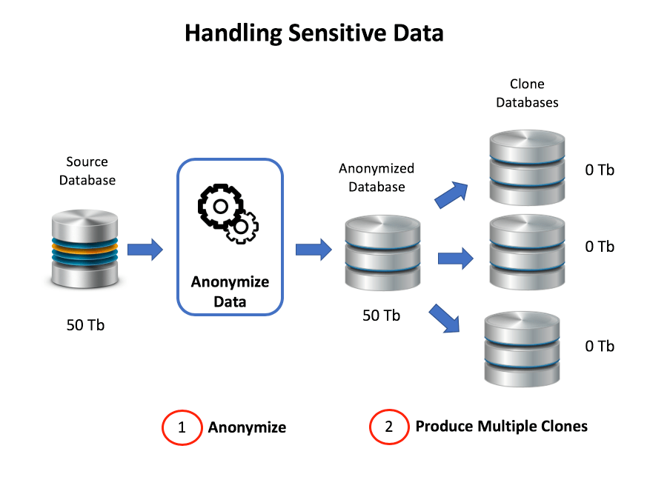
PII Data
What is PII Data?
https://basecamp.temenos.com/s/article-detail/a046A00000ATBipQAH/understanding-the-personal-data
How should we handle this data?
Notes:
Who here has heard of GDPR or CCPA
The General Data Protection Regulation (EU) 2016/679 (GDPR) is a regulation in EU law on data protection and privacy in the European Union (EU) and the European Economic Area (EEA). It also addresses the transfer of personal data outside the EU and EEA areas. The GDPR aims primarily to give control to individuals over their personal data and to simplify the regulatory environment for international business by unifying the regulation within the EU.^{[1]} Superseding the Data Protection Directive 95/46/EC, the regulation contains provisions and requirements related to the processing of personal data of individuals (formally called data subjects in the GDPR) who are located in the EEA, and applies to any enterprise—regardless of its location and the data subjects' citizenship or residence—that is processing the personal information of data subjects inside the EEA.
With the California Consumer Privacy Act (CCPA) taking effect in January 2020, companies have limited time to get a handle on the customer information they have and how they need to care for it. If they don’t, they not only risk being fined, but also loss of brand reputation and consumer trust — which are immeasurable.
California was one of the first states to provide an express right of privacy in its constitution and the first to pass a data breach notification law, so it was not surprising when state lawmakers in June 2018 passed the CCPA, the nation’s first statewide data privacy law. The CCPA isn’t just a state law — it will become the defacto national standard for the foreseeable future, because the sheer numbers of Californians means most businesses in the country will have to comply. The requirements aren’t insignificant. Companies will have to disclose to California customers what data of theirs has been collected, delete it and stop selling it if the customer requests. The fines could easily add up — $7,500 per violation if intentional, $2,500 for those lacking intent and $750 per affected user in civil damages.
One of other challenges faced by data warehouse projects involves the need to anonymize production data for development purposes. This may involve either removing or masking sensitive data.
The diagram above illustrates the best practice approach for management of anonymized data. This involves a two-stage process: -
Anonymize the data: Which involves duplicating the source tables to create an anonymized copy, removing or replacing sensitive data as appropriate.
Clone the copy: Which produces one or more zero copy clones of the anonymized data. As each clone adds zero additional data storage, this adds no additional storage cost.
Using this method, multiple development and test database clones can be taken at zero additional cost from the anonymized copy.
One of the biggest challenges when working in an agile manner on data warehouse projects is the time and effort involved in replicating and physically transporting data for development and test cycles. When combined with the cost of hardware, storage and maintenance, this can be a significant challenge for most projects.
https://community.snowflake.com/s/article/Agile-Data-Warehouse-Development

Slide 11
Roles and Permissions
Use permissions and roles to give access
Adjust access based on how they will be working with the database
Roles and permissions can be granted with a few lines of code
Dealing with taxing the system
One bad query can stall a system
Set rules to suspend queries that run for longer than hour
Set up a resource monitor
Set alerts for groups or warehouses to have a set number of credits
Notes:
use role accountadmin; create or replace resource monitor limit1 with credit_quota=1000 triggers on 50 percent do notify on 75 percent do notify on 100 percent do suspend on 110 percent do suspend_immediate; alter warehouse wh1 set resource_monitor = limit1;
STATEMENT_TIMEOUT_IN_SECONDS
TypeSession and Object (for warehouses)
Can be set for Account » User » Session; can also be set for individual warehouses
Data TypeNumber
DescriptionAmount of time, in seconds, after which a running SQL statement (query, DDL, DML, etc.) is canceled by the system.
The parameter can be set within the session hierarchy. It can also be set for an individual warehouse to control the runtime for all SQL statements processed by the warehouse. When the parameter is set for both a warehouse and a session, the lowest non-zero value is enforced. For example:
A warehouse has a timeout of 1000 seconds.
The timeout for the session is set to 500 seconds.
The session timeout takes precedence (i.e. any statement submitted in the session is canceled after running for longer than 500 seconds).
Values0 to 604800 (i.e. 7 days) — a value of 0 specifies that the maximum timeout value is enforced.
Default172800 (i.e. 2 days)

Slide 12
Maintenance around Infrastructure
Automatic Clustering
No updating indexes and statistics
Post-load vacuuming procedures
Picking distribution keys
Dealing with slow partitions
Manually reordering data
Materialized views and automatic maintenance
Multiple MVs with different clustering keys = improved query performance
Scalable compute service: no infrastructure to manage
Similar to Snowflake’s automatic clustering with the ability to resume or suspend per table, a user can resume and suspend the automatic maintenance on per MV basis
Notes:
Automatic clustering
No need to run manual operations to re-cluster data.
Incremental clustering as new data arrives or a larger amount of data is modified.
ETL pipelines consisting of DML operations (INSERT, DELETE, UPDATE, MERGE) can run concurrently and are not blocked.
Users can resume and suspend automatic clustering on a per table basis, and are billed by the second for only the compute resources used.
Vacuuming is a post load resort of the data
Materialized views
Materializing single table aggregations.
Materializing query results and analysis against semi-structured data, using flatten or approximate queries (sampling).
Scalable compute service
In case of the background clustering, the compute service continuously monitors the clustering quality of all registered clustered tables. It starts with the most unclustered micro-partitions, and iteratively performs the clustering until an optimal clustering depth is achieve

Slide 13
Idempotency
What is an Idempotency?
One can apply a certain operation on something many times, without changing the result of the operation after the first time the operation is applied.
The GET method is idempotent, as multiple calls to the GET resource will always return the same response.
The PUT method is idempotent, as calling the PUT method multiple times will update the same resource and not change the outcome
Notes:
Idempotent REST APIs
If clients can make that same call repeatedly while producing the same result, for example :- avoid processing a transaction multiple times.
The GET method is idempotent, as multiple calls to the GET resource will always return the same response.
The PUT method is idempotent, as calling the PUT method multiple times will update the same resource and not change the outcome.
The POST is not idempotent, and calling the POST method multiple times can have different results and will result in creating new resources.
The DELETE is idempotent because once the resource is deleted, it is gone and calling the method multiple times will not change the outcome.

Slide 14

Ensuring Data Integrity
What is Data Integrity?
Data integrity refers to the reliability and trustworthiness of data throughout its lifecycle
Error checking and validation
Retrievability and accessibility
Traceability
Reliability
Preserve data Integrity
Validate input & data
Remove Duplicate data
Back up data
Access controls
Audit trails
Notes:
Don’t throw away data
retaining data provides a mechanism to manage the ordering of high-volume data sets without losing track of what information has or hasn’t been processed
It is also creates the opportunity to perform event-based analytics on the sub sections of the data stream and look for anomalies (or specific conditions) that trigger notifications like a security alert.
Executing Parallel COPY Statements That Reference the Same Data Files
Data integrity is not to be confused with data security. Data security refers to the protection of data, while data integrity refers to the trustworthiness of data
Retrievability and accessibility – It’s important to have accurate data in the proper locations at the right time when anyone is working on projections, a deal, or presentation. Without proper and easy access and retrieval, it can be detrimental to the business, yielding the way for your competition to win.
Traceability –Today, you can trace every touchpoint you make with a prospect or customer. How? With a data point. The data can inform decision makers, highlight red flags, deficiencies, or limitations. Make sure these touchpoints are accurate.
Reliability – Having reliable, consistent business metrics against company goals and the competition is what will take an organization to the top.
Validate Input: When your data set is supplied by a known or unknown source (an end-user, another application, a malicious user, or any number of other sources) you should require input validation. That data should be verified and validated to ensure that the input is accurate.
Validate Data: It’s critical to certify that your data processes haven’t been corrupted. Identify specifications and key attributes that are important to your organization before you validate the data.
Remove Duplicate Data: Sensitive data from a secure database can easily find a home on a document, spreadsheet, email, or in shared folders where employees without proper access can see it. It’s prudent to clean up stray data and remove duplicates.
Back up Data: In addition to removing duplicates to ensure data security, data backups are a critical part of the process. Backing up is necessary and goes a long way to prevent permanent data loss. How often should you be backing up? As often as possible. Keep in mind that backups are critical when organizations get hit with ransomware attacks. Just make sure that your backups aren’t also encrypted!
Access Controls: –Individuals within an organization without proper access and with malicious intent can do grave harm to the data. What’s worse, an outsider impersonating an insider can also be detrimental. Implementing a least privilege model – where only users who need access to data get access – is a very successful form of access control. What’s often overlooked is physical access to the server. The most sensitive servers should be isolated and bolted to the floor or wall. Only individuals who access should have an access key – ensuring that the keys to the kingdom are kept secure.
Always Keep an Audit Trail: Whenever there is a breach, it’s critical to data integrity to be able to track down the source. Often referred to as an audit trail, this provides an organization the breadcrumbs to accurately pin point the source of the problem.
As a best practice, it’s better to load files above 100 Mb and below 1 Gb than it is to load many smaller files for both load and query performance.

Slide 15
Compression to Maximize Storage
Compress loaded data especially when data is large
Select your Codec
Short for compressor/decompressor
Snappy
Provides lossless compression that is not splittable
Integrated into Hadoop Common and often used for database compression
Snappy compression ratio is around 2x
Notes:
Data File Compression
We recommend that you compress your data files when you are loading large data sets. See CREATE FILE FORMAT for the compression algorithms supported for each data type.
When loading compressed data, specify the compression method for your data files. The COMPRESSION file format option describes how your data files are already compressed in the stage. Set the COMPRESSION option in one of the following ways:
As a file format option specified directly in the COPY INTO <table> statement.
As a file format option specified for a named file format or stage object. The named file format/stage object can then be referenced in the COPY INTO <table> statement.

Slide 16
Block Store and Mounting
Block store will break files into smaller pieces, also called chunks, or simply blocks
As a best practice, it’s better to load files above 100 Mb and below 1 Gb than it is to load many smaller files for both load and query performance
Split large data files into smaller pieces to load faster and catch errors
Notes:
Benefits of inserting data in pieces rather than one large file
This way of storing data makes block storage ideal for latency critical applications such as transactional databases or mission-critical data as it is faster, latency-wise, than a traditional file-storage device
Imagine a file is equivalent to a building – by breaking it into pieces you can carry smaller pieces to move
The split utility enables you to split a CSV file into multiple smaller files
STRIP_OUTER_ARRAY file format option for the COPY INTO <table> command to remove the outer array structure and load the records into separate table rows
Currently, data loads of large
Parquet files (e.g. greater than 3 GB) could time out. Split large files into files 1 GB in size (or smaller) for loading
Snowpipe queue management and the actual load

Slide 17

Confused? ASK QUESTIONS

Slide 18
Break & Lab 2

